Slide 1

Android & iOS Build-In Tools
www.pragmatic.bg
Lector: Dimitar Topuzov
E-mail: dtopuzov@gmail.com
LinkedIn: http://bg.linkedin.com/pub/dimitar-topuzov/18/470/833/en
Copyright © Pragmatic LLC 2018

Slide 2
Content
Android
Adb monkey
Espresso
UI Automator
iOS
XCTest

Slide 3
Adb Monkey
The Monkey generates pseudo-random streams of
User events such as clicks, touches, or gestures
Number of system-level events
You can use the Monkey to stress-test applications in a random yet repeatable manner

Slide 4
Adb Monkey
The Monkey includes a number of options, but they break down into four primary categories:
Basic configuration options, such as setting the number of events to attempt
Operational constraints, such as restricting the test to a single package
Event types and frequencies
Debugging options

Slide 5
Adb Monkey
When the Monkey runs it watches the system under test and looks for three conditions:
If you have constrained the Monkey to run in one or more specific packages, it watches for attempts to navigate to any other packages, and blocks them.
If your application crashes or receives any sort of unhandled exception, the Monkey will stop and report the error.
If your application generates an application not responding error, the Monkey will stop and report the error.

Slide 6
Adb Monkey
Simple usage
Launch app and send 500 pseudo-random events to it
adb shell monkey -p io.selendroid.testapp -v 500
Add 500ms delay
adb shell monkey -p io.selendroid.testapp --throttle 500 -v 500
Execute exactly the same sequence
adb shell monkey -p io.selendroid.testapp –s 120 -v 500
-s <seed>
Specify patterns by adding
--pct-touch <percent>
--pct-nav <percent>

Slide 7
monkeyrunner
Important
The monkeyrunner tool is not related to the monkey tool
monkeyrunner
The monkeyrunner tool provides an API (Python) for writing programs that control an Android device or emulator from outside of Android code
With monkeyrunner, you can write a Python program that installs an Android application or test package, runs it, sends keystrokes to it, takes screenshots of its user interface, and stores screenshots on the workstation.

Slide 8
Espresso
The Espresso testing framework provides a set of APIs to build UI tests to test user flows within an app
Well-suited for writing white box-style automated tests, where the test code utilizes implementation code details from the app under test
Handles synchronization between the Instrumentation and the UI thread
Requires Android 2.2 (API level 8) or higher
Recorder is available in latest Android Studio

Slide 9
Espresso Recorder
How to start it:
Start Android Studio
Open existing project with Android app
Click Run > Record Espresso Test.
...do the recording
Right-click on the test and click Run ‘testName.’

Slide 10
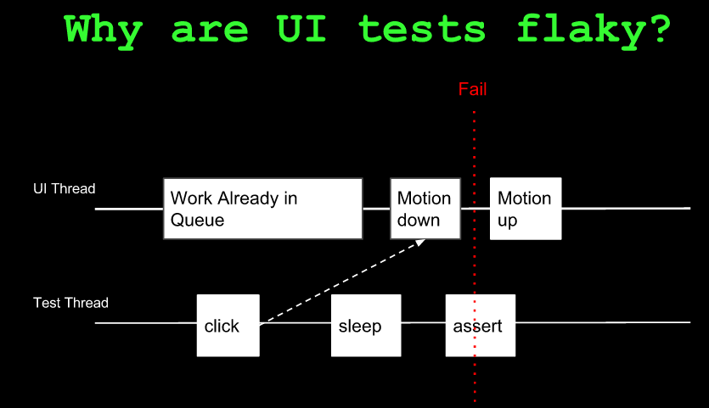
Espresso

Slide 11
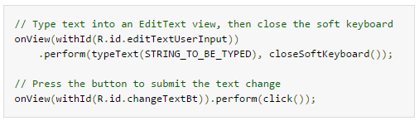
Espresso
Example:
Tutorial
https://developer.android.com/training/testing/ui-testing/espresso-testing.html

Slide 12
UI Automator
Summary
Framework that perform interactions on user apps and system apps
Test does not rely on internal implementation details of the target app
Key features
A viewer to inspect layout hierarchy (UI Automator Viewer)
An API to retrieve state information and perform operations on the target device.
APIs that support cross-app UI testing
Android 4.3 (API level 18) or higher

Slide 13
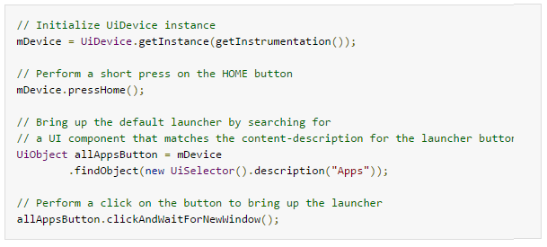
UI Automator
Example
Tutorial
https://developer.android.com/training/testing/ui-testing/uiautomator-testing.html

Slide 14
XCTest
Info
https://developer.apple.com/reference/xctest
Demo
…you will se later ☺

Slide 15

Questions

